Slide 1
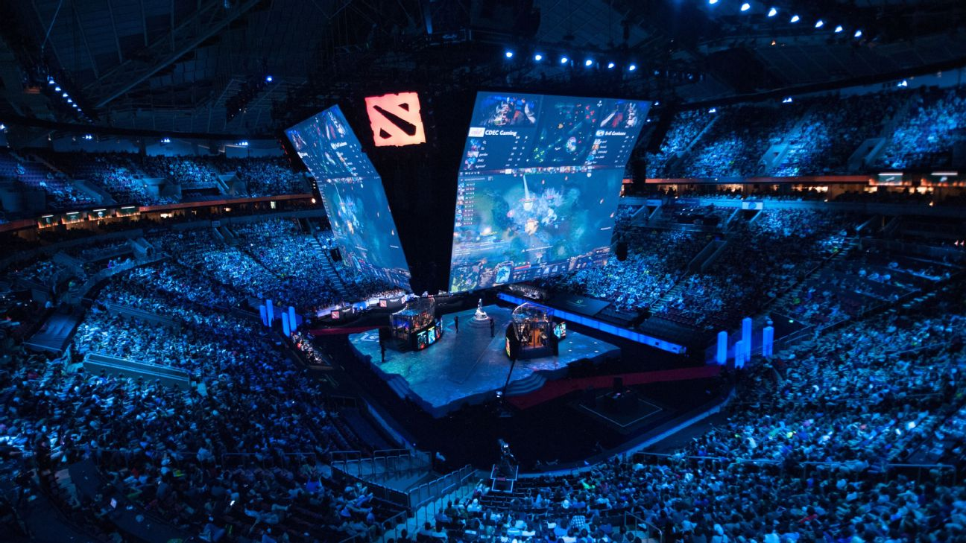
Predicting match outcome from “Dota 2” e-sports
Team:
Aanal Patel
Aniketh Vaglapuram
Bimal Shresta
Danilo Diaz
Ernie Sumoso
Siddharth Yadav

Slide 2




Problem Statement
Predicting the match winner in any sport is always challenging because it depends on many underlying factors.
Videogame and e-sport “Dota 2” is not an exception, with even more variables to consider.
This is a classification problem with various independent features to explore and large amounts of data.
Viewers / gamblers
Business Value
Value to different actors of the community:
Viewers interested in gambling can have extra insights about the match outcome, increasing their chance of winning by making more informed decisions.
Teams & coaches can use this tool as an additional level of analysis that helps build a strategy for their upcoming matches.
Tournament players can identify their strengths/weaknesses by testing predictions with different values
Teams & Coaches
Our Goal
Tournament Players
Predicting the match outcome before it starts, which makes the prediction even harder, but more valuable.

Slide 3
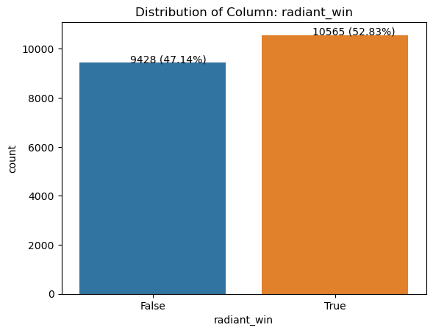
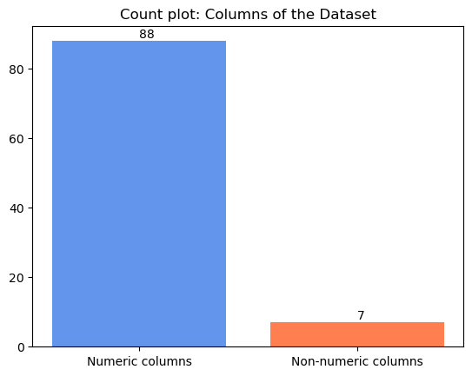
Our real-world data
95 columns
20’000 rows
Target values nearly balanced
We developed a project “dota2Analytics” hosted on GitHub, that makes API calls to multiple requests from OpenDotaAPI source and generates our dataset.

Slide 4
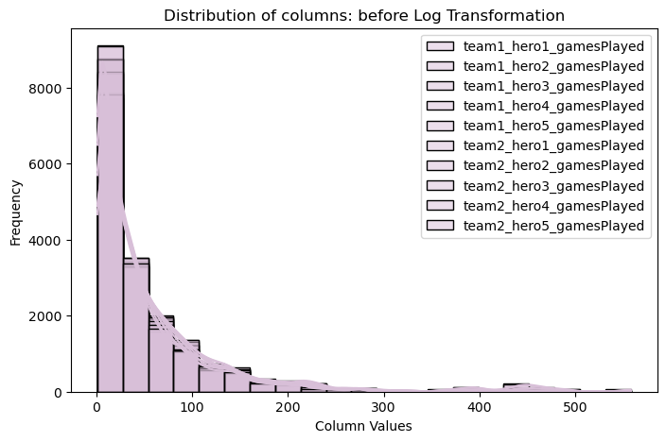
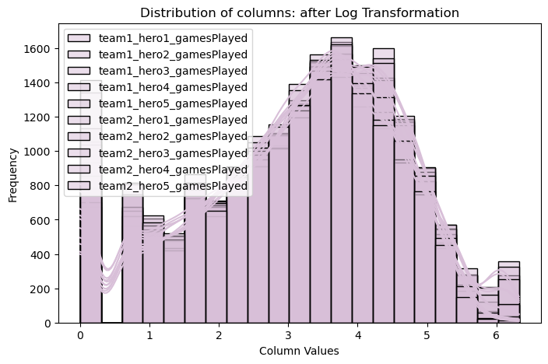
Pre-processing & Normalization
Missing values → Omission technique
Duplicated rows → No duplicated rows
Outliers treatment →
Flooring & Capping
☆ Log Transformation ☆
Feature selection →
Drop features with < 10% correlation to target
Drop features with shared correlation
Standard Scaling
Feature extraction →
New features from datetime columns
☆ PCA features ☆ (0.99 variance and 5 components)
Kernel PCA features
☆ LDA features ☆ (1 component)

Slide 5
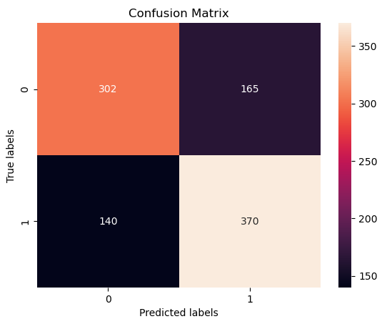
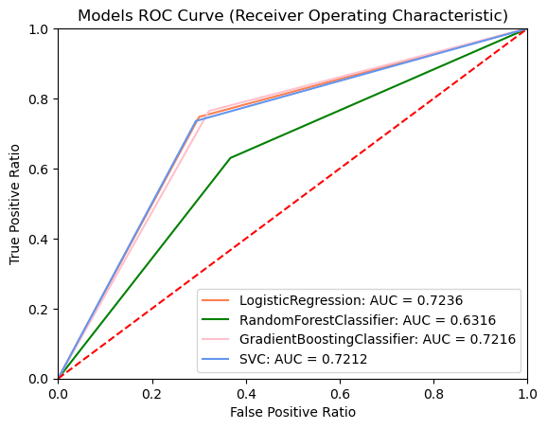
Classification Models
Split dataset
Train & Test classification models:
Logistic Regression
Random Forest
Gradient Boosting
Support Vector Machine
Hyperparameter tuning
Grid Search CV
Comparing models
Accuracy Score & F1 Score
Confusion Matrix
ROC Curve
Increasing Complexity
Interaction features (degrees 2)
☆ Polynomial features ☆ (degrees 2, 4, 6)
Evaluating models (new data 1,000 rows)
Save best model:
☆ Gradient Boosting – LDA dataset – polynomial degree 6 ☆

Slide 6

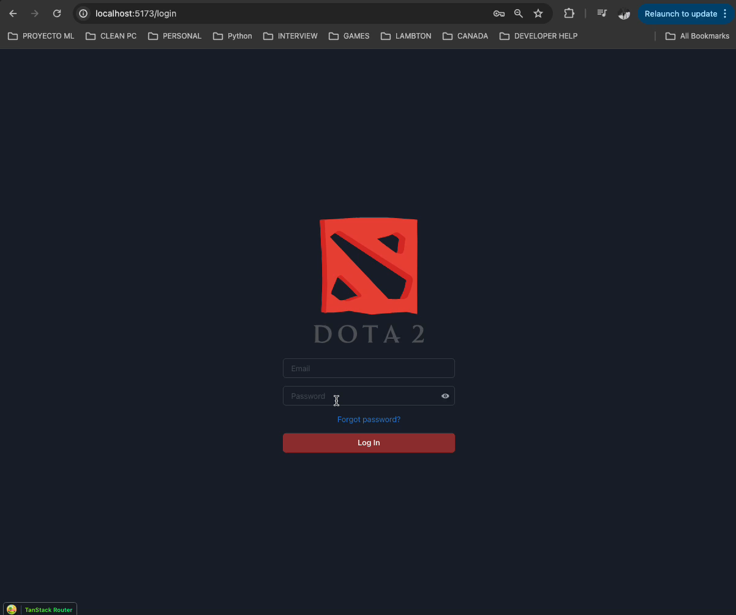
Final Product: Project “dota2Analytics” hosted on GitHub

Slide 7

Resources
Thanks!
Do you have any questions?
Gough, C. (2024, February). Leading eSports tournaments worldwide as of February 2024. Retrieved April 14, 2024, from https://www.statista.com/statistics/517940/leading-esports-tournamets-worldwide-by-prize-pool/
Howard, C. (2023). GitHub - odota/dotaconstants: Constant data for Dota applications. GitHub. https://github.com/odota/dotaconstants/tree/master
Diaz, D. (April 2024). GitHub - NILodio/dota2Analytics at master. GitHub. https://github.com/NILodio/dota2Analytics/tree/master
OpenDota API 25.0 Official Documentation. (2023). Open Dota Source https://docs.opendota.com/
Wijman, T. (2023, December). The 2023 Global Games market in numbers. Newzoo. Retrieved April 14, 2024, from https://newzoo.com/resources/blog/video-games-in-2023-the-year-in-numbers

